Slide 1

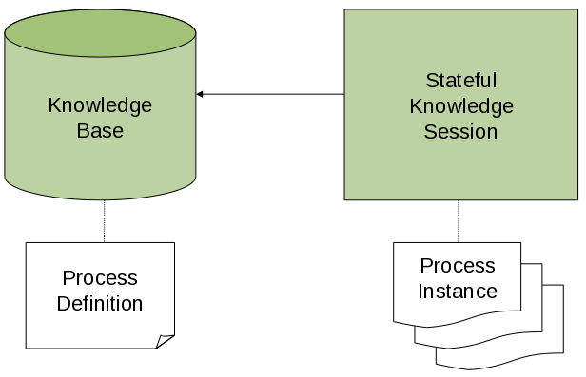
Understanding of Knowledge API
Notes:
Welcome back to the forth module of data science.

Slide 2
Agenda
01
02
03
Core Engine API
Runtime Management
KIE REST API
04
05
06
JAVA Client API
quiz
Sample Project
07
conclusion

Slide 3
Core Engine API

Slide 4
Core Engine API
To interact with the jBPM engine (for example, to start a process), you need to set up a session. This session will be used to communicate with the jBPM engine. A session needs to have a reference to a KIE base, which contains a reference to all the relevant process definitions. This KIE base is used to look up the process definitions whenever necessary.
To create a session, you first need to create a KIE base, load all the necessary process definitions (this can be from various sources, like from classpath, file system or process repository) and then instantiate a session.
Once you have set up a session, you can use it to start executing processes. Whenever a process is started, a new process instance is created (for that process definition) that maintains the state of that specific instance of the process.

Slide 5
Core Engine API

Slide 6
KieBase
The jBPM API allows you to first create a KIE base. This KIE base should include all your process definitions that might need to be executed by that session.
To create a KIE base, use a KieHelper to load processes from various resources (for example from the classpath or from the file system), and then create a new KIE base from that helper.

Slide 7
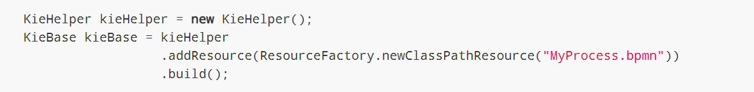
KieBase
The following code snippet shows how to create a KIE base consisting of only one process definition (using in this case a resource from the classpath).

Slide 8
KieSession
Once you’ve loaded your KIE base, you should create a session to interact with the engine. This session can then be used to start new processes, signal events, etc. The following code snippet shows how easy it is to create a session based on the previously created KIE base, and to start a process (by id).

Slide 9
RuntimeManager
RuntimeManager will ensure that regardless of the strategy it will provide same capabilities when it comes to initialization and configuration of the RuntimeEngine. That means
KieSession will be loaded with same factories (either in memory or JPA based)
WorkItemHandlers will be registered on every KieSession (either loaded from db or newly created)
Event listeners (Process, Agenda, WorkingMemory) will be registered on every KieSession (either loaded from db or newly created)
TaskService will be configured with:
JTA transaction manager
same entity manager factory as for the KieSession
UserGroupCallback from environment
On the other hand, RuntimeManager maintains the engine disposal as well by providing dedicated methods to dispose RuntimeEngine when it’s no more needed to release any resources it might have acquired.

Slide 10
Services
On top of RuntimeManager API a set of high level services has been provided from jBPM version 6.2. These services are meant to be the easiest way to embed (j)BPM capabilities into custom application. A complete set of modules are delivered as part of these services. They are partitioned into several modules to ease thier adoptions in various environments.
jbpm-services-api - contains only api classes and interfaces
jbpm-kie-services - rewritten code implementation of services api - pure java, no framework dependencies
jbpm-services-cdi - CDI wrapper on top of core services implementation
jbpm-services-ejb-api - extension to services api for ejb needs
jbpm-services-ejb-impl -EJB wrappers on top of core services implementation
jbpm-services-ejb-timer - scheduler service based on EJB TimerService to support time based operations e.g. timer events, deadlines, etc
jbpm-services-ejb-client - EJB remote client implementation - currently only for JBoss Service modules are grouped with its framework dependencies, so developers are free to choose which one is suitable for them and use only that.

Slide 11
Configuration
There are several control parameters available to alter engine default behavior. This allows to fine tune the execution for the environment needs and actual requirements.
All of these parameters are set as JVM system properties, usually with -D when starting program e.g. application server.

Slide 12
Runtime Management

Slide 13
Runtime Management
Deployments
Process Deployments

Slide 14
KIE REST API

Slide 15
KIE REST API
jBPM provides a KIE Server REST API that you can use to interact with your KIE containers and business assets (such as business rules, processes, and solvers) in jBPM without using the jBPM Workbench user interface. This API support enables you to maintain your jBPM resources more efficiently and optimize your integration and development with jBPM.
With the KIE Server REST API, you can perform the following actions:
Deploy or dispose KIE containers
Retrieve and update KIE container information
Return KIE Server status and basic information
Retrieve and update business asset information
Execute business assets (such as rules and processes)

Slide 16
JAVA CLIENT API

Slide 17
Java Client API
jBPM provides a KIE Server Java client API that enables you to connect to KIE Server using REST protocol from your Java client application. You can use the KIE Server Java client API as an alternative to the KIE Server REST API to interact with your KIE containers and business assets (such as business rules, processes, and solvers) in jBPM without using the jBPM Workbench user interface.
This API support enables you to maintain your jBPM resources more efficiently and optimize your integration and development with jBPM.
With the KIE Server Java client API, you can perform the following actions also supported by the KIE Server REST API:
Deploy or dispose KIE containers
Retrieve and update KIE container information
Return KIE Server status and basic information
Retrieve and update business asset information
Execute business assets (such as rules and processes)

Slide 18

Quiz
KIE API

Slide 19
Quiz
You can connect jBPM in loosely fashion using
REST API
Java Client API
Connectors
Java Integration

Slide 20

Answers
You can connect jBPM in loosely fashion using
REST API
Java Client API
Connectors
Java Integration

Slide 21
Quiz
jbpm-services-api contains only api classes and interfaces
True
False

Slide 22
Answers
jbpm-services-api contains only api classes and interfaces
True
False

Slide 23
Sample jBPM Project

Slide 24
Conclusion

Slide 25


Summary
In this session, you have learnt:
Core Engine API
Runtime Management
KIE REST API
Java Client API
Sample jBPM Project

Slide 26

India : +91-7847955955
US : 1-800-216-8930 (TOLL FREE)
support@intellipaat.com
24X7 Chat with our Course Advisor
Notes:
Thank you!

